Slide 1
UDP - User Datagram Protocol

Slide 2
UDP
It's a communication protocol used in computer networks, particularly within the Internet Protocol suite.
It is called a connectionless, unreliable transport protocol.
When should use UDP?
If a process wants to send a small message and does not care much about reliability, it can use UDP. Sending a small message by using UDP takes much less interaction between the sender and receiver than using TCP

Slide 3
UDP Operation
Data is sent in the form of datagrams.
Each datagram is handled independently.
If a datagram is lost, UDP does not retransmit it.
No connection setup or teardown – the sender just sends, and the receiver just listens.

Slide 4
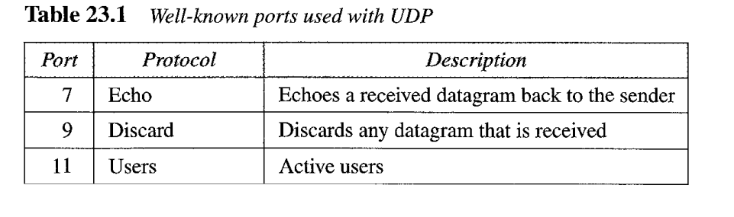
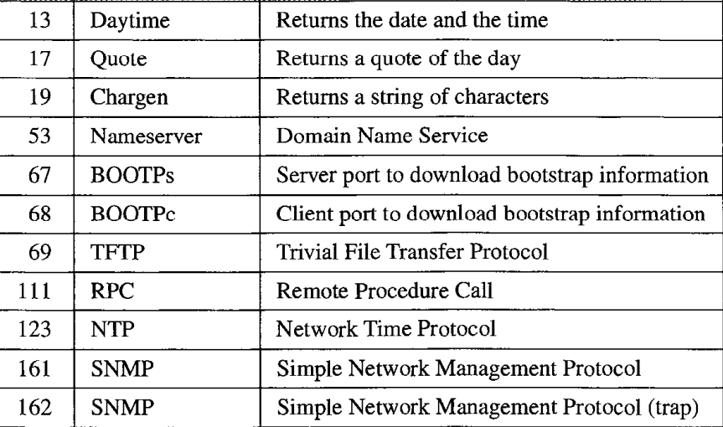
Well-Known Ports for UDP

Slide 5
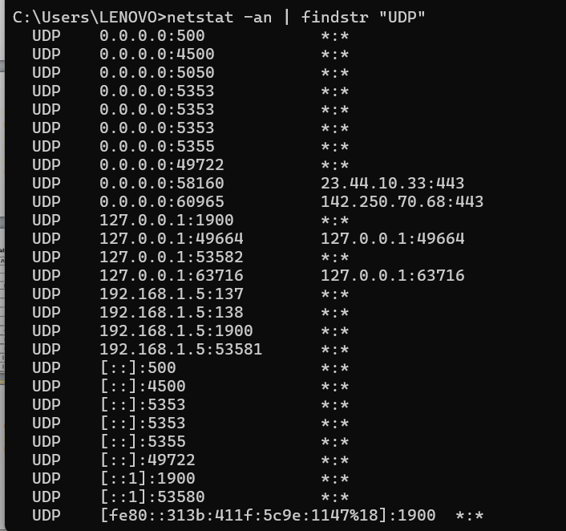
Check for active UDP ports:
netstat -an | findstr "UDP“
It will show all listening and connected UDP ports on your system.

Slide 6
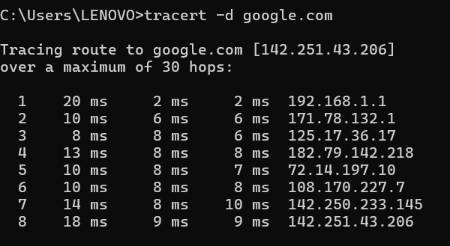
Is UDP protocol using in windows OS?
some examples of where UDP is used :DNS, ICMP,SNMP, Media Streaming and etc.
The tracert -d command in Windows is used to trace the route that packets take to reach a destination without resolving IP addresses to domain names.

Slide 7
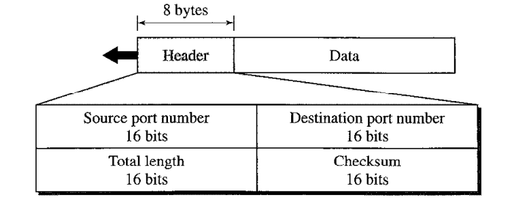
User datagram Format

Slide 8
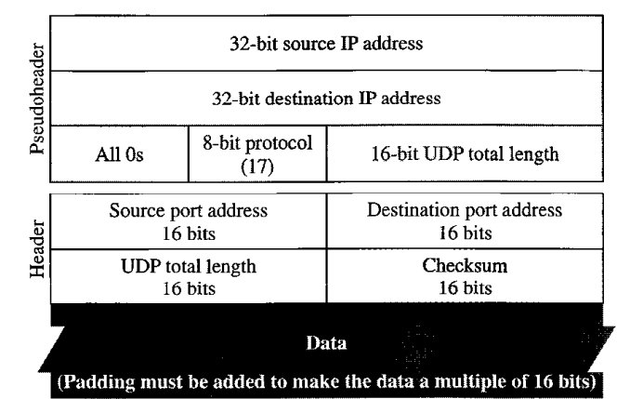
Pseudo header for checksum calculation

Slide 9
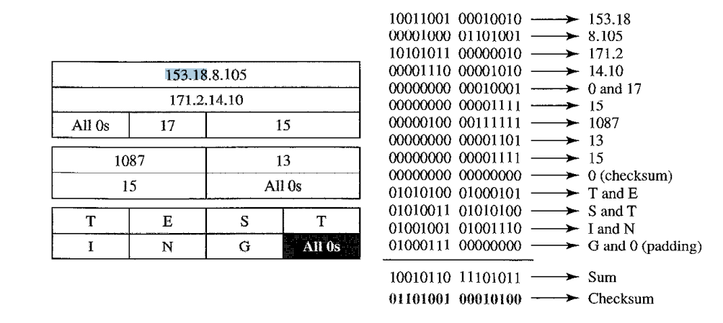
Checksum calculation ofa simple UDP user datagram

Slide 10
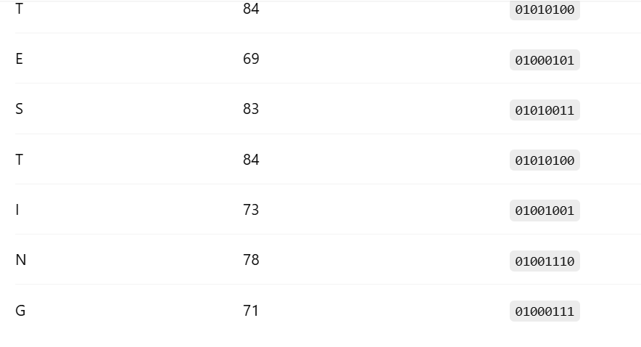

Slide 11
Queue in UDP
Send Queue (Transmit Queue)
When an application sends data using UDP (sendto() or sendmsg()), the data is placed in the kernel's send queue before being handed off to the NIC (Network Interface Card).
If the network is slow or congested, this queue may grow temporarily.
Receive Queue
When the network stack receives a UDP packet, it places it in the receive queue of the corresponding socket
The application must call recvfrom() or similar to read packets from this queue.

Slide 12
